Slide 1

Chapter 4
Gates and Circuits

Slide 2
Chapter Goals
Identify the basic gates and describe the behavior of each
Describe how gates are implemented using transistors
Combine basic gates into circuits
Describe the behavior of a gate or circuit using Boolean expressions, truth tables, and logic diagrams

Slide 3
Chapter Goals
Compare and contrast a half adder
and a full adder
Describe how a multiplexer works
Explain how an S-R latch operates
Describe the characteristics of the four generations of integrated circuits

Slide 4
Computers and Electricity
Gate
A device that performs a basic operation on
electrical signals
Circuits
Gates combined to perform more
complicated tasks

Slide 5
Computers and Electricity
How do we describe the behavior of gates and circuits?
Boolean expressions
Uses Boolean algebra, a mathematical notation for expressing two-valued logic
Logic diagrams
A graphical representation of a circuit; each gate has its
own symbol
Truth tables
A table showing all possible input values and the associated
output values

Slide 6
Gates
Six types of gates
  NOT
  AND
  OR
  XOR
  NAND
  NOR
Typically, logic diagrams are black and white with gates distinguished only by their shape
We use color for clarity (and fun)

Slide 7
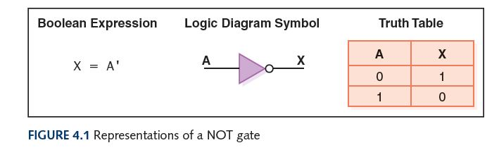
NOT Gate
A NOT gate accepts one input signal (0 or 1) and returns the complementary (opposite) signal as output

Slide 8
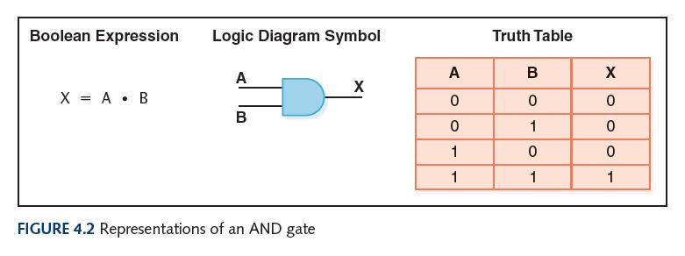
AND Gate
An AND gate accepts two input signals
If both are 1, the output is 1; otherwise,
the output is 0

Slide 9
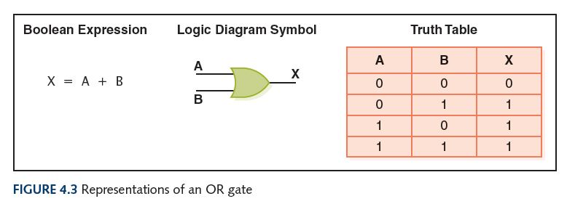
OR Gate
An OR gate accepts two input signals
If both are 0, the output is 0; otherwise,
the output is 1

Slide 10
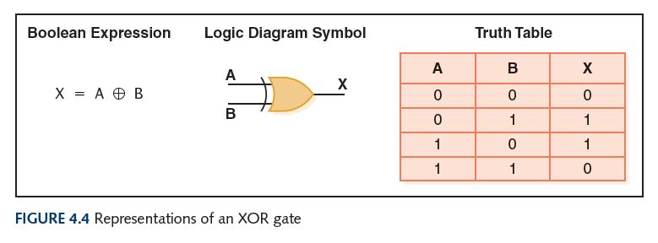
XOR Gate
An XOR gate accepts two input signals
If both are the same, the output is 0; otherwise,
the output is 1

Slide 11
XOR Gate
Note the difference between the XOR gate
and the OR gate; they differ only in one
input situation
When both input signals are 1, the OR gate produces a 1 and the XOR produces a 0
XOR is called the exclusive OR because its output is 1 if (and only if):
either one input or the other is 1,
excluding the case that they both are

Slide 12
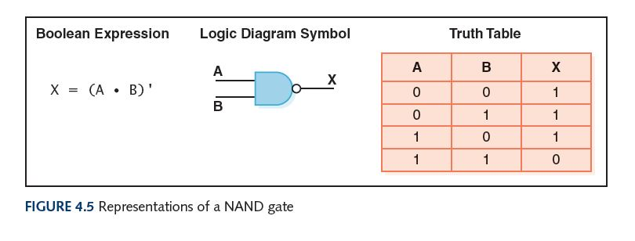
NAND Gate
The NAND (“NOT of AND”) gate accepts two input signals
If both are 1, the output is 0; otherwise,
the output is 1

Slide 13
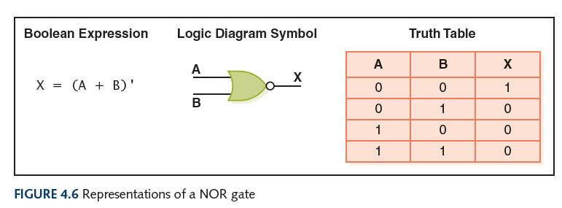
NOR Gate
The NOR (“NOT of OR”) gate accepts two inputs
If both are 0, the output is 1; otherwise,
the output is 0

Slide 14
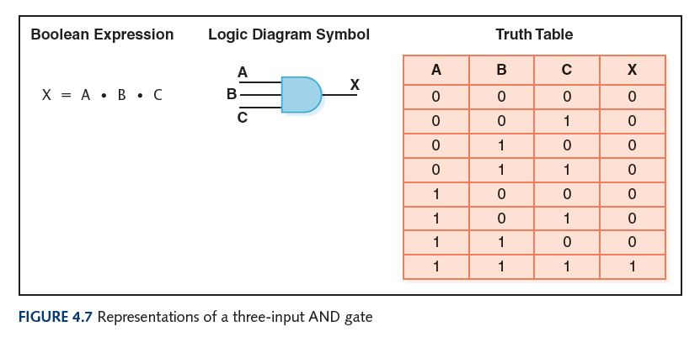
Gates with More Inputs
Some gates can be generalized to accept three or more input values
A three-input AND gate, for example, produces an output of 1 only if all input values are 1

Slide 15
Review of Gate Processing
Gate | Behavior
NOT | Inverts its single input
AND | Produces 1 if all input values are 1
OR | Produces 0 if all input values are 0
XOR | Produces 0 if both input values are the same
NAND | Produces 0 if all input values are 1
NOR | Produces 1 if all input values are 0

Slide 16
Constructing Gates
Transistor
A device that acts either as a wire that conducts electricity or as a resistor that blocks the flow of electricity, depending on the voltage level of an input signal
A transistor has no moving parts, yet acts like
a switch
It is made of a semiconductor material, which is neither a particularly good conductor of electricity nor a particularly good insulator

Slide 17
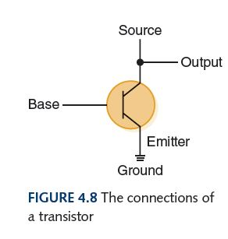
Constructing Gates
Note: If an electrical signal is grounded, it is “pulled low” to zero volts
A transistor has three terminals
  A collector (or source)
  A base
  An emitter
What’s the Output in Figure 4.8?
  If the Base signal is low, the transistor acts like an open switch, so the Output is the same as the Source
  If the Base signal is high, the transistor acts like a closed switch, so the Output is pulled low
What gate did we just describe?

Slide 18
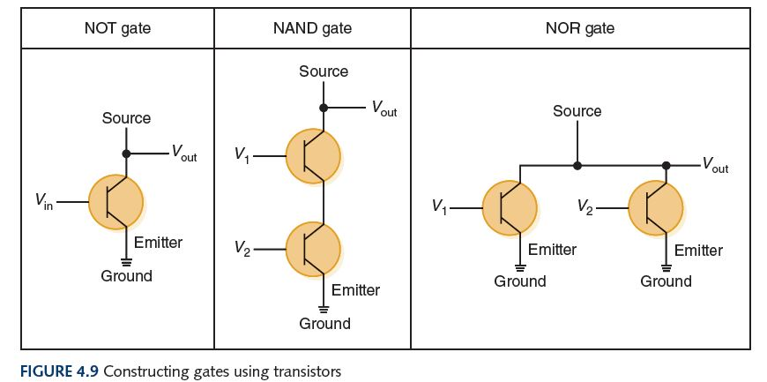
Constructing Gates
The easiest gates to create are the NOT, NAND, and NOR gates

Slide 19
Circuits
Combinational circuit
The input values explicitly determine the output
Sequential circuit
The output is a function of the input values and the existing state of the circuit
We describe the circuit operations using
  Boolean expressions
  Logic diagrams
  Truth tables
Are you surprised?

Slide 20
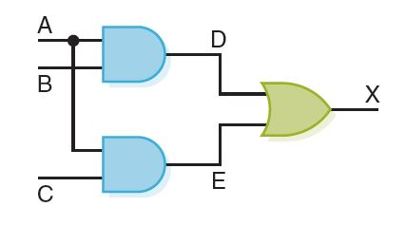
Combinational Circuits
Gates are combined into circuits by using the output of one gate as the input for another
This same circuit using a Boolean expression is AB + AC

Slide 21
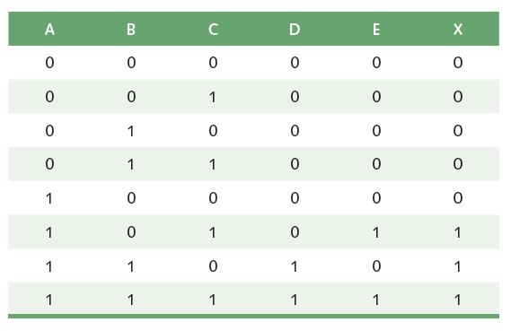
Combinational Circuits
Three inputs require eight rows to describe all possible input combinations

Slide 22
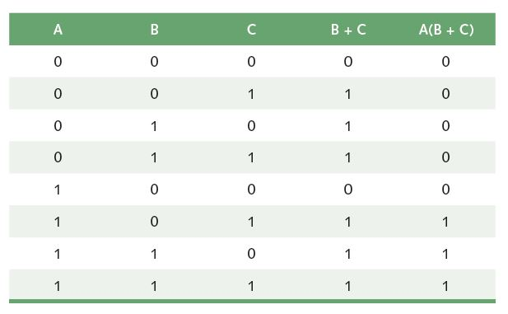
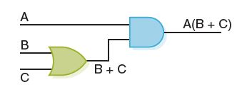
Combinational Circuits
Consider the following Boolean expression A(B + C)
Does this truth table look familiar?
Compare it with previous table

Slide 23
Combinational Circuits
Circuit equivalence
Two circuits that produce the same output for identical input
Boolean algebra
Allows us to apply provable mathematical principles to help design circuits
A(B + C) = AB + BC (distributive law) so circuits must be equivalent

Slide 24
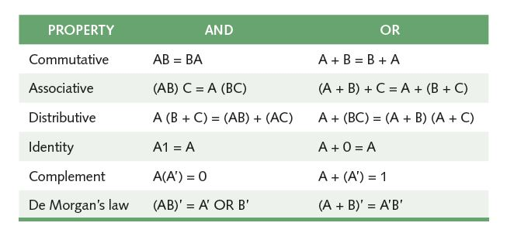
Properties of Boolean Algebra

Slide 25
Adders
At the digital logic level, addition is performed in binary
Addition operations are carried out
by special circuits called, appropriately, adders

Slide 26
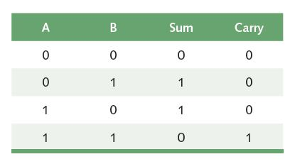
Adders
The result of adding two binary digits could produce a carry value
Recall that 1 + 1 = 10
in base two
Half adder
A circuit that computes the sum of two bits
and produces the correct carry bit
Truth table

Slide 27
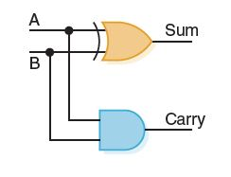
Adders
Circuit diagram representing
a half adder
Boolean expressions
sum = A ⊕ B
carry = AB

Slide 28
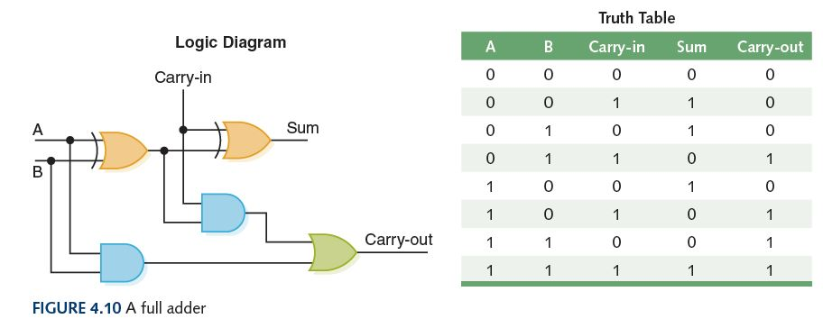
Adders
Full adder
A circuit that takes the carry-in value into account

Slide 29
Multiplexers
Multiplexer (or MUX)
A circuit that uses a few input control signals to determine which of several input data signals is routed to its output signal

Slide 30
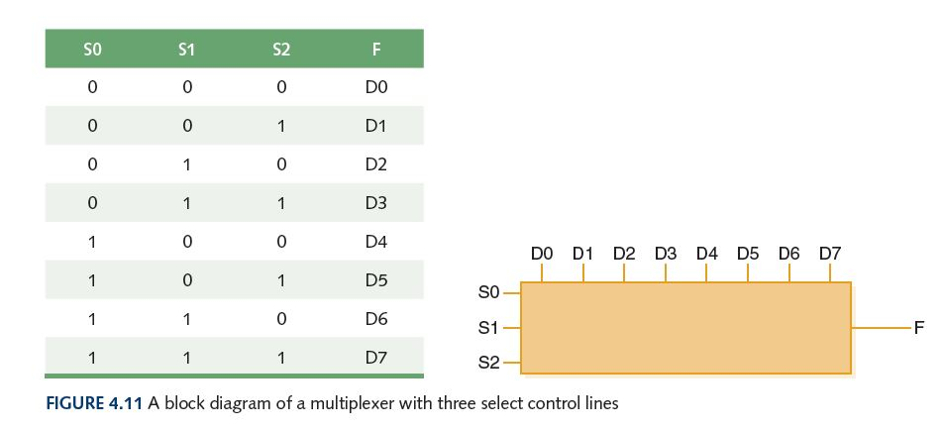
Multiplexers
The control lines S0, S1, and S2 determine which of eight other input lines (D0 … D7) are routed to the output (F)

Slide 31
Circuits as Memory
Digital circuits can be used to store information
These circuits form a sequential circuit, because the output of the circuit is also used as input to the circuit

Slide 32
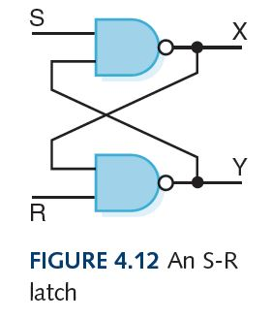
Circuits as Memory
An S-R latch stores a single binary digit
(1 or 0)
There are several ways an S-R latch circuit can be designed using various kinds of gates

Slide 33
Circuits as Memory
Assume that S and R are never both 0 at the same time
The design of this circuit guarantees that the two outputs X and Y are always complements of each other
The value of X at any point in time is considered to be the current state of the circuit
Therefore, if X is 1, the circuit is storing a 1; if X is 0, the circuit is storing a 0

Slide 34
Integrated Circuits
Integrated circuit (also called a chip)
A piece of silicon on which multiple gates have been embedded
Silicon pieces are mounted on a plastic or ceramic package with pins along the edges that can be soldered onto circuit boards or inserted into appropriate sockets

Slide 35
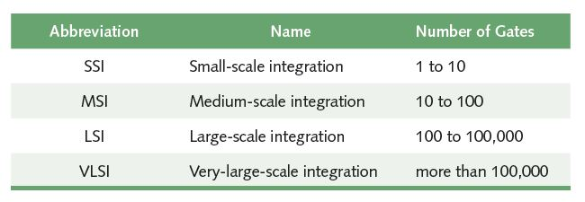
Integrated Circuits
Historically, integrated circuits have been classified by the number of gates (or transistors) they contain
As of 2014, chips exist with over 20 billion transistors

Slide 36
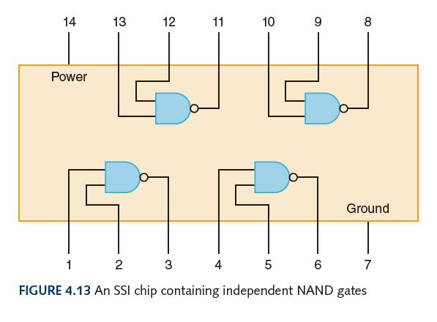
Integrated Circuits

Slide 37
CPU Chips
The most important integrated circuit
in any computer is the Central Processing Unit, or CPU
Each CPU chip has a large number of pins through which essentially all communication in a computer system occurs

Slide 38
Ethical Issues
Codes of Ethics
Which professional organization is more focused on the hardware side?
Which is more focused on the software side?
How are their codes of ethics alike?
How do they differ?

Slide 39
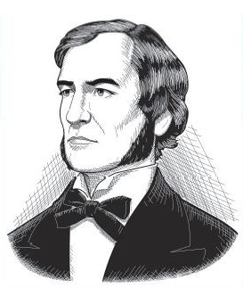
Who am I?
I didn’t get much recognition at the time,
but my book formed the basis for the
development of digital computers.
Can you name its contribution?

Slide 40

Do you know?
What is the name of the study of materials
smaller than 100 nanometers?
What topic in computer science education
is referred to as “the tenth strand”?
Who wrote about the fundamental problem
of expressing thought by means of symbols?
What did Maurice Wilkes realize in 1949?
What two (or more) concepts can be
referred to by the term “computer ethics”?

